Slide 1
Macros and Macro Processors
Presented by: Foram Thakor

Slide 2
Overview
Introduction
Macro Definition and Call
Macro Expansion
Nested Macro Calls
Advanced Macro Facilities
Design of a Macro Preprocessor
Design of a Macro Assembler
Functions of a Macro Processor
Basic Tasks of Macro Processor
Design Issues of Macro Processors

Slide 3
Macros
A macro is a sequence of instructions or statements that can be reused multiple times in a program.
Instead of writing the same code repeatedly, you define it as a macro and call it when needed.
Macros help in reducing code duplication and improving maintainability.
A macro is a facility for extending a programming language .
A macro either defines a new operation or a new method for declaring data .
The language processor replaces a call on a macro by a sequence of statements that implements the defined operation or the method of declaring data.
Many languages that support macro: C, C++

Slide 4
Macro Definition
Macro definitions are typically located at the start of a program.
A macro definition is enclosed between a macro header statement(MACRO) and a macro end statement(MEND)
Format of macro definition:
MACRO
macroname <formal parameters>
body
MEND

Slide 5
Macro Definition (Contd.)
A macro definition consist of macro prototype statement and body of macro.
A macro prototype statement declares the name of a macro and its parameters. MACRO indicates the beginning of macro definition and parameters indicates the list of formal parameters.
Parameters is of the form &parameter1, &parameter2,…Each parameter begins with ‘&’.
Whenever we use the term macro prototype it simply means the macro name along with its parameters.
Body of macro consist of statements that will generated as the expansion of macro.

Slide 6
Macro Definition (Contd.)
Consider the following macro definition:
MACRO
SUM &X,&Y
LDA &X
MOV B
LDA &Y
ADD B
MEND
Here, the macro named SUM is used to find the sum of two variables passed to it.

Slide 7
Macro Call (or Macro Invocation)
A macro invocation statement (a macro call) gives the name of the macro instruction being invoked and the arguments to be used in expanding the macro.
When a macro is invoked in the code, it is referred to as a macro call. The macro processor replaces this call with the macro body.
The format of macro invocation:
macroname p1, p2,...pn
The above defined macro can be called as SUM P,Q

Slide 8
Macro Expansion
Each macro invocation statement will be expanded into the statements that form the body of the macro.
Arguments from the macro invocation are substituted for the parameters in the macro prototype.
The arguments and parameters are associated with one another according to their positions.
The first argument in the macro invocation corresponds to the first parameter in the macro prototype, etc.
Comment lines within the macro body have been deleted, but comments on individual statements have been retained.
Macro invocation statement itself has been included as a comment line.

Slide 9
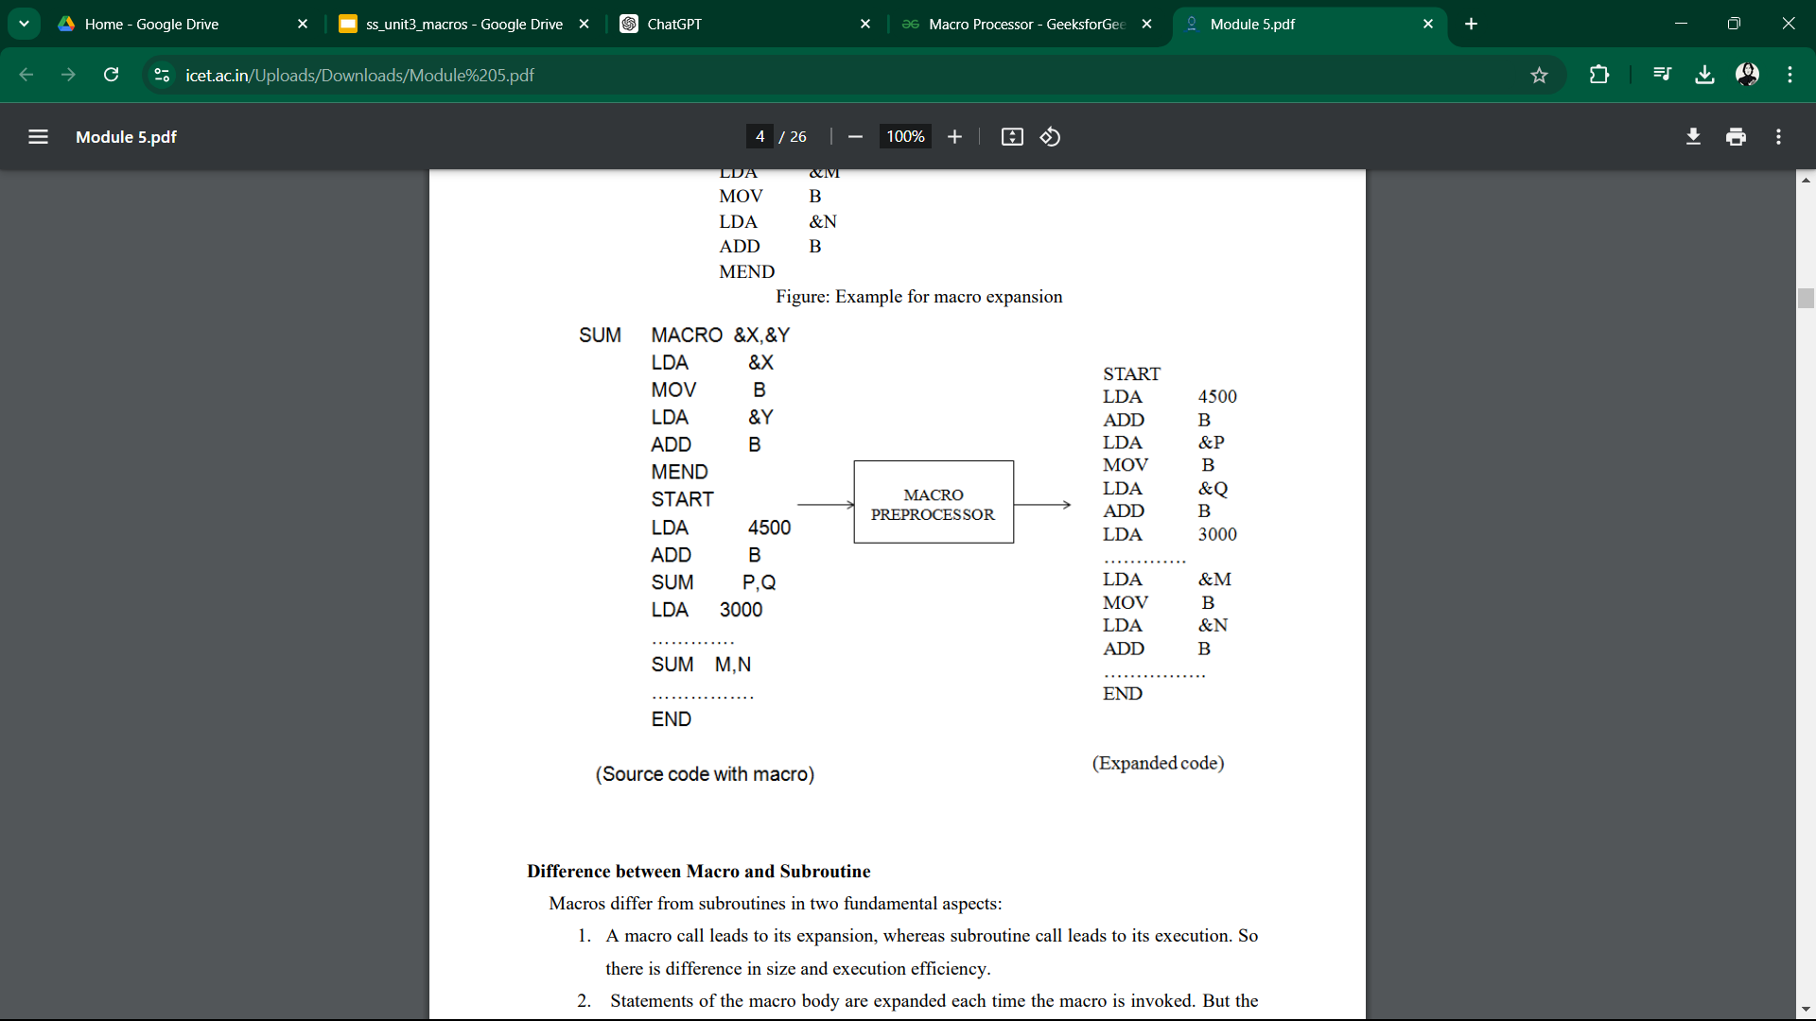
Maceo Expansion (Contd.)

Slide 10
Types of Statements
Macro Prototype
A macro prototype defines the macro’s name, parameters, and the structure of the macro. It serves as a template or blueprint for the macro, specifying how it should be invoked and what arguments it requires.
Model Statement
Model statements are the actual instructions within a macro that perform operations. They are the core executable statements that define the actions to be carried out when the macro is expanded.
Macro Preprocessor Statements
Macro preprocessor statements are special directives used within macros to control the behavior of the macro processor. These statements manage macro expansion, conditional logic, iteration, and other preprocessing tasks.

Slide 11
Nested Macro Calls
A nested macro call occurs when one macro calls or invokes another macro within its definition.
This creates a hierarchical or nested structure where macros are expanded within other macros.
This allows for complex functionality to be modularized and reused, enhancing the flexibility and efficiency of macro programming.
The macro that contains the nested call is called outer macro and the macro that is called in the nested call is inner macro.
The pre-processor performs expansion of nested macro calls LIFO order

Slide 12
Key Concepts of Nested Macro Calls
Macro Expansion:
When a macro is called, the macro processor replaces the macro name with its corresponding body (the set of instructions).
In nested macro calls, during the expansion of one macro, another macro is invoked and expanded.
The expansion process continues until all macro calls are fully resolved.
Hierarchy of Macros:
Outer Macro: The macro that contains another macro call within its body.
Inner Macro: The macro that is called from within the outer macro.

Slide 13
Key Concepts of Nested Macro Calls
3. Parameters:
Both the outer and inner macros can have parameters.
These parameters are passed and expanded separately for each macro call.
The arguments passed to each macro are processed independently, allowing different values to be used in different levels of nested calls.
4. Macro Processor Behavior:
The macro processor must handle each level of nesting separately.
It expands the inner macro first, replacing it with its instructions, before continuing to expand the outer macro.
This requires the macro processor to keep track of multiple expansion contexts

Slide 14
Example of Nested Macro calls
Macro Definition:
PUSH_ALL MACRO
PUSH AX
PUSH BX
PUSH CX
PUSH DX
ENDM
POP_ALL MACRO
POP DX
POP CX
POP BX
POP AX
ENDM
Outer Macro Calling Nested Macro
PROCESS_DATA MACRO
PUSH_ALL ; Call to nested macro
; Perform some operations here
POP_ALL ; Call to nested macro
ENDM
Expanded Macro call: START: PUSH AX PUSH BX PUSH CX PUSH DX ; Perform some operations here POP DX POP CX POP BX POP AX
Macro Calling: START: PROCESS_DATA ;

Slide 15
Advanced Macro Facilities
Advanced macro facilities enhance the capabilities of macros in programming, allowing for more complex and efficient code generation.
These facilities include features such as flow control alterations, conditional expansions, expansion time variables, and loops during macro expansion.
Alteration of Flow Controls
This facility allows macros to control the flow of execution during their expansion.
It can include conditional statements and loops, enabling macros to behave like control structures.
This is useful when the behavior of the macro needs to change based on specific conditions, reducing redundancy in code.

Slide 16
Advanced Macro Facilities
#SYNTAX
IF <condition>
; code to include if condition is true
ELSE
; code to include if condition is false
ENDIF

Slide 17
Advanced Macro Facilities
2. Expansion Time Variables
These are variables that can be defined within a macro and retain values during the macro's expansion.
They allow for dynamic behavior and state management within the macro.
Useful for maintaining state or counters within a macro, such as keeping track of how many times a macro has been called.
#SYNTAX
MACRO_NAME MACRO
SET variable = value
; use variable
ENDM

Slide 18
Advanced Macro Facilities
3. Conditional Expansions
This feature allows certain parts of the macro to be included or excluded based on conditions evaluated at the time of expansion.
This is beneficial for generating different code paths based on compile-time configurations or flags, allowing for more flexible and adaptable code.
#SYNTAX
MACRO_NAME MACRO
IF condition
; statements to include
ENDIF
ENDM

Slide 19
Advanced Macro Facilities
4. Local Variables in Macros
Local variables (LCL) and global variables (GBL) allow defining variables that are either local to the macro or accessible globally across multiple macros.
Use local variables to store temporary values that are only needed during macro expansion and should not interfere with variables outside the macro.
#SYNTAX
LCL &LOCAL_VAR ; Define a local variable
GBL &GLOBAL_VAR ; Define a global variable

Slide 20
Design of a Macro Preprocessor
A macro preprocessor is a tool that processes macros before the actual compilation or assembly of code.
It replaces macros with their defined instructions or code segments and performs various tasks like conditional compilation, file inclusion, and macro expansion.
The macro preprocessor accepts an assembly program containing macro definitions and calls, and translates it into an equivalent assembly program without any macro definitions or calls.
The output program can then be processed by an assembler to generate the target object program.

Slide 21
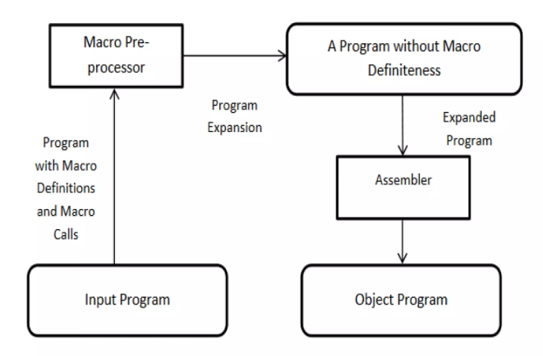
Design of a Macro Preprocessor

Slide 22
Key tasks performed by Macro Preprocessor
Identify Macro Calls:
Recognize when a macro call is made in the program.
Determine Values of Formal Parameters:
Capture the values passed to the macro.
Maintain Expansion Time Variables:
Keep track of variables declared during macro expansion.
Organize Control Flow:
Manage how the macro executes based on the parameters.
Determine Sequencing Symbols:
Handle symbols that control the order of execution.
Perform Expansion of Model Statements:
Replace macro calls with the corresponding code.

Slide 23
Data Structures used by Macro Preprocessors
Macro Name Table (MNT):
Stores macro names, the number of positional and keyword parameters, pointers to the Macro Definition Table (MDT), and other relevant metadata.
Parameter Name Table (PNT):
Contains names of formal parameters.
Expansion Time Variable Table (EVT):
Maintains information about expansion time variables.
Sequencing Symbol Table (SST):
Contains sequencing symbols that control the flow of macro execution.
Keyword Parameter Default Table (KPDT):
Holds keyword parameters and their default values.

Slide 24
Data Structures used by Macro Preprocessors
6. Macro Definition Table (MDT):
Stores the actual body of the macro definitions.
7. Actual Parameter Table (APT):
Holds the actual parameters passed during macro calls.
8. Expansion Time Variable Name Table (EVNT):
Contains names of expansion time variables.
9. Sequencing Symbol Name Table (SSNT):
Contains name/s of all the available sequencing symbol in a macro definition.

Slide 25
Data Structures used by Macro Preprocessors
TABLE NAME | ENTRY FIELDS
Macro Name Table (MNT) | - name: Macro name - pp: Number of positional parameters - kp: Number of keyword parameters - ev: Number of expansion time variables - mdtPtr: Pointer to Macro Definition Table (MDT) - kpdtPtr: Pointer to Keyword Parameter Default Table (KPDT) - sstPtr: Pointer to Sequencing Symbol Table (SST)
Parameter Name Table (PNT) | - paramName: Name of the formal parameter
Expansion Time Variable Table (EVT) | - varName: Name of the expansion time variable

Slide 26
Data Structures used by Macro Preprocessors
Data Structures used by Macro Preprocessors
TABLE NAME | ENTRY FIELDS
Sequencing Symbol Table (SST) | -symbolName: Name of the sequencing symbol
Keyword Parameter Default Table (KPDT) | - paramName: Name of the keyword parameter - defaultValue: Default value of the keyword parameter
Macro Definition Table (MDT) | - label: Label of the statement - opcode: Opcode of the statement - operand: Operand of the statement
Actual Parameter Table (APT) | - paramName: Name of the actual parameter - value: Value of the actual parameter
Expansion Time Variable Name Table (EVNT) | - varName: Name of the expansion time variable

Slide 27
Algorithm for Macro Expansion
Initialization: Set the Macro Expansion Counter (MEC) to the starting point of the macro.
Check for MEND: While the statement pointed to by MEC is not a MEND statement:
If the statement is a model statement, expand it and increment MEC.
If it is a control statement, update MEC based on the control logic specified.
Parameter Substitution: Replace formal parameters in the model statements with actual parameters from the APT.
Output Generation: Generate the output assembly code by substituting the expanded statements in place of the macro calls.
End Expansion: Once all macro calls are processed, the preprocessor outputs the final assembly program without any macro definitions.

Slide 28
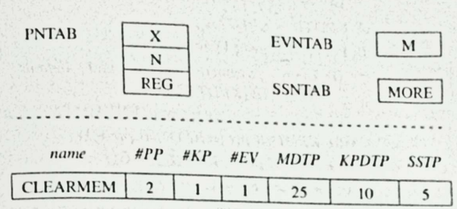

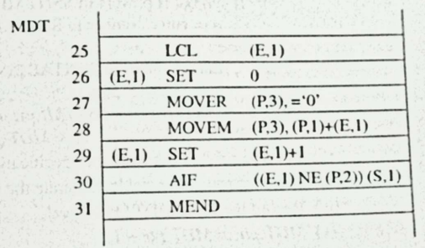
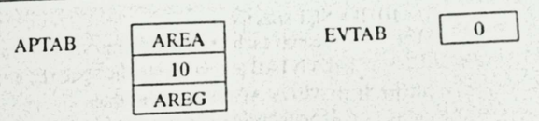
Example of Macro Preprocessor Working
Consider a macro definition and call
MACRO
CLEARMEM &X, &N, &REG=AREG
LCL &M
&M SET 0
MOVER &REG, = ‘0’
.MORE MOVEM &REG, &X+&M
&M SET &M+1
AIF (&M NE N).MORE
MEND
Macro call
CLEARMEM AREA,10

Slide 29
Design of Macro Assembler
A macro assembler extends the functionality of a standard assembler by supporting macro instructions.
These macros are essentially placeholders for code snippets that can be reused throughout the assembly code.
The macro assembler handles macro definitions and expansions, providing a more flexible and modular approach to assembly programming.
The assembler performs this translation through a series of passes over the source code, allowing it to resolve symbols and generate the corresponding machine instructions.

Slide 30
Key Components of a Macro Assembler
Macro Definition Table (MDT)
Stores the definitions of macros, including the macro body with placeholders for parameters.
Facilitates macro expansion by providing the code to substitute for each macro invocation.
Macro Name Table (MNT)
Maintains a list of macro names and their corresponding identifiers or addresses in the MDT.
Allows quick lookup of macro names to retrieve their definitions.
Argument List Array (ALA)
Stores the arguments provided for each macro invocation.
Supplies the macro processor with arguments to replace placeholders in the macro body.

Slide 31
Different Types of Assemblers
Single-Pass Assembler
Functionality: Scans the source code only once to generate machine code.
Process:
Reads each line of the source code.
Translates instructions into machine code immediately.
Requires all symbols to be defined before they are used (no forward references).
Advantages: Faster, as it only requires one scan of the source code.
Disadvantages: Limited flexibility due to the need for all symbols to be defined beforehand.

Slide 32
Different Types of Assemblers
2. Multi-Pass Assembler
Functionality: Scans the source code multiple times.
Process:
First Pass: Builds a symbol table containing all symbols and their addresses.
Subsequent Passes: Uses the symbol table to translate the assembly code into machine code.
Advantages: More flexible, allowing symbols to be used before they are defined.
Disadvantages: Slower, as it requires multiple scans of the source code.

Slide 33
Functions of Macro Processors
A macro processor is responsible for processing macros in assembly language programs.
It provides a means to automate the repetition of code sequences by allowing the use of macros.
The macro processor works independently of the assembler, providing macro expansion before the actual assembly process.
A macro processor is a component that processes macro definitions and macro calls in assembly language programs.

Slide 34
Key Functions of Macro Processor
Macro Definition Handling:
The macro processor identifies macro definitions in the source code and stores them in the Macro Definition Table (MDT).
It also records macro names and their addresses in the Macro Name Table (MNT).
Macro Invocation Handling:
When the macro processor encounters a macro invocation, it retrieves the corresponding macro definition from the MDT and the arguments from the Argument List Table (ALT).
It substitutes actual arguments into the macro body.

Slide 35
Key Functions of Macro Processor (Contd.)
3. Macro Expansion
The macro processor expands the macro invocations by substituting arguments into the macro body and generates the expanded code.
This process simplifies repetitive code.
4. Nested Macro Handling
The macro processor can handle nested macro calls, where one macro invokes another macro within its body.
It manages the expansion in a recursive manner to handle multiple levels of macro calls.

Slide 36
Key Functions of Macro Processor (Contd.)
5. Conditional Macro Expansion
Some macro processors support conditional macro expansions, where certain code is expanded based on conditions like argument values or external parameters.
6. Error Detection
The macro processor identifies errors related to incorrect macro invocations, such as missing arguments or invalid syntax.
It provides appropriate error messages for troubleshooting.

Slide 37
Basic Tasks of Macro Processor
Macro Definition Recognition:
The macro processor scans the source code and identifies macro definitions using specific keywords like MACRO and MEND.
Parameter Substitution:
The macro processor replaces formal parameters (like &ARG1, &ARG2) in the macro definition with actual arguments provided during invocation.
Expansion of Macro Calls:
It replaces macro invocations with the actual code body (macro expansion) in the source code.

Slide 38
Basic Tasks of Macro Processor (Contd.)
4. Maintaining Data Structures:
The processor maintains key data structures:
MDT (Macro Definition Table): Stores macro bodies.
MNT (Macro Name Table): Holds macro names and their locations in the MDT.
ALT (Argument List Table): Maps actual arguments to formal parameters during macro invocation.
5. Output of Expanded Code:
The final output from the macro processor is the expanded source code, which can then be passed to the assembler.

Slide 39
Difference B/W Macro Processor & Macro Assembler
FEATURES | MACRO PROCESSORS | MACRO ASSEMBLER
Purpose | Processes macro definitions and expansions | Translates assembly language into machine code
Functionality | Expands macros and handles parameter substitution | Performs macro expansion and assembles the resulting code
Output | Produces an assembly program with expanded macros | Generates the final machine code from the assembly program
Independence | Can operate independently or as part of an assembler | Typically integrated with the assembler

Slide 40
Difference B/W Macro Processor & Macro Assembler
Execution Time | Processes macros at assembly time | Executes during the assembly process
Error Handling | Checks for macro definition and usage errors | Handles errors related to assembly language syntax
Data Structures Used | Utilizes tables like MNT, MDT, APT, etc. | Uses symbol tables, opcode tables, etc.
Macro Expansion | Focuses solely on expanding macros | Expands macros and generates machine code

Slide 41
Design Issues of Macro Processor
Design Issue | Description | Proposed Solutions
Macro Definition and Invocation | Clear syntax for defining macros and identifying calls | Consistent format (e.g., MACRO, MEND), robust parsing
Parameter Handling | Management of formal and actual parameters | Use APT and PNT data structures
Expansion Time Control Flow | Organizing control flow during expansion | Implement sequencing symbol management
Error Detection and Handling | Identifying errors in macro definitions or calls | Incorporate error-checking mechanisms
Memory Management | Efficiently managing memory for storing definitions and parameters | Optimize memory allocation strategies

Slide 42
Design Issues of Macro Processor
Recursive Macro Definitions | Supporting macros that invoke themselves | Maintain state information to prevent infinite loops
Code Size Management | Managing increased code size due to expansions | Minimize unnecessary expansions; provide inline options
Machine Independence | Ensuring design is independent of hardware architecture | Focus on high-level abstractions
Integration with Assemblers | Seamless integration between macro processor and assembler | Define clear interfaces for output/input

Slide 43


